Slide 1

Stage 7
Aim Faster
Course Designer: Eric Beerbaum
Aim Faster is a 22 round, 110 point Comstock long course. There are 11 IPSC targets. The best two hits per target will score. The start signal is audible
The Handgun start position is standing anywhere outside shooting area, handgun loaded and holstered, wrists below belt.
The PCC start position is standing anywhere outside shooting area, PCC loaded, stock on belt, muzzle pointing down range.
On the audible start signal, engage targets as they become visible.
Notes:
‹#›

Slide 2
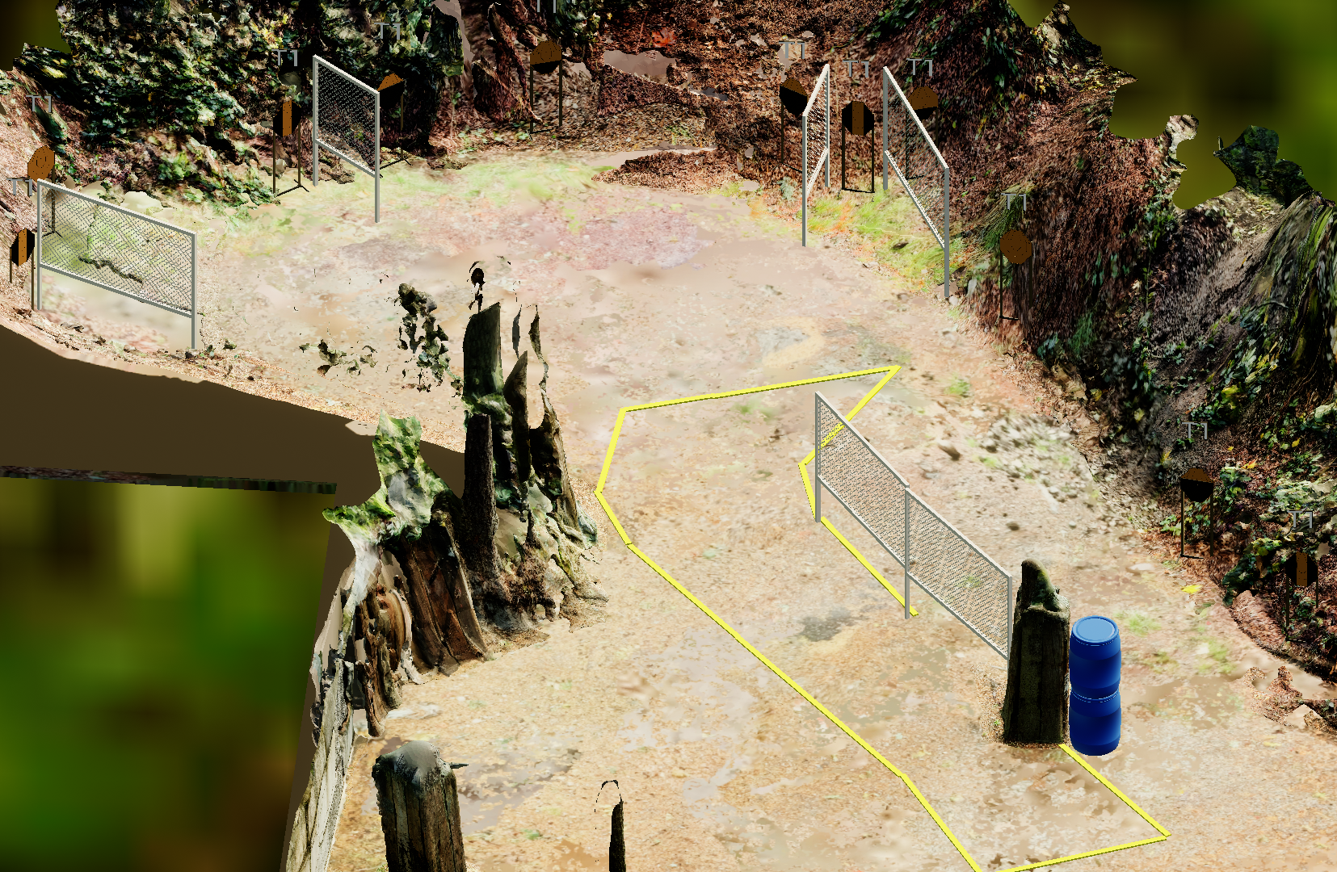
 | Stage 7 Aim Faster Course Designer: Eric Beerbaum
Notes:
‹#›

